Slide 1
The Problem with Short-Term Memory
Karyn Z. Sproles, PhD
Director, Center for Teaching& Learning

Slide 2
What is the problem with short term (or working) memory?
Think
Pair
Share

Slide 3
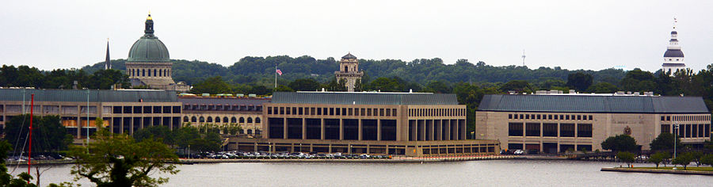
Long term memory increases with need

Slide 4

Short term memory is finite

Slide 5

How can we get short term memories into long term memory?

Slide 6
4 Ways you can help during MGSP
Predictions
Spaced retrieval
Self-Explaining
Connections

Slide 7
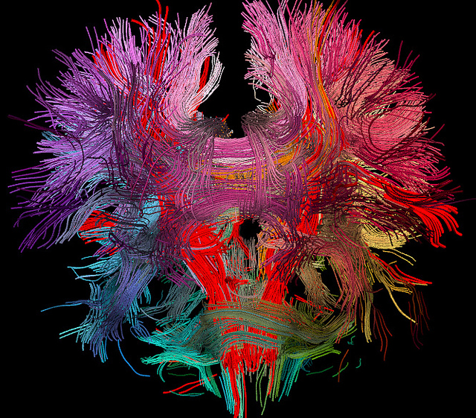
Result: Meaningful Learning

